Slide 1
Introduction to Investments, Asset Classes, Risk and Return
Dr. Natasha Todorovic

Slide 2
SMM148 Securities & Investments Course…
… introduces basic investment concepts (i.e. theory) used by various financial institutions (i.e. investment banks, asset management companies, etc.)
…introduces the applications of these investment concepts that we will study further in SMM201 Asset Management & Sustainable Investing in Term 2
… introduces the key financial instruments and ways to value them (equities, fixed income and derivatives)
… analyses relationship between risk and return:
  Diversification: process of risk reduction in a portfolio of assets
  Construction of portfolios that maximise returns given client’s risk requirements or portfolios that minimise risk given level of required return
  CAPM and other factor models

Slide 3
Investment and Investment Process

Slide 4
What is an investment?
Commitment of funds to assets that will be held over the future time period.
Real assets vs. financial assets
  Real assets are physical, tangible assets such as gold or real estate
  Financial assets are paper (electronic) claims on some issuer (e.g. corporation or government)
  Type of financial assets investors are mainly interested in are marketable securities
Investment refers in general to financial assets and in particular to marketable securities.
  Marketable securities are financial assets that are easily traded on the organised exchanges
  Impersonal trading

Slide 5
Why do we invest?
The purpose is to increase one’s wealth
  Wealth = current income or funds + present value of all income in the future
  We are concerned with monetary wealth
Get a return on the money, do not hold cash.
  Opportunity cost
  Inflation
  Purchasing power diminishes
Protect yourself from inflation, taxes, etc. and make returns!

Slide 6
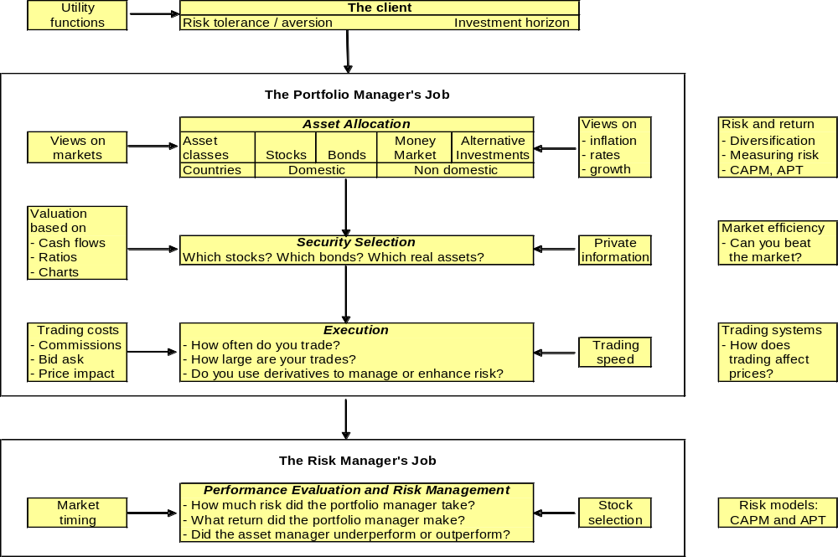
Investment process

Slide 7
Asset classes as part of investment portfolio

Slide 8
Traditional vs. alternative asset classes
Traditional asset classes:
  Equities: Domestic vs. International
    Holders: Shareholders
  Fixed Income (Bonds and Money Market Instruments (Cash))
    Holders: Debt holders
Alternative asset classes:
  Real Estate
  Commodities
  Private Equity
  Hedge Funds
  Infrastructure

Slide 9
Traditional assets: who gets paid first? Priority of investor income claims
Company cash available for investors is distributed in a strict order:
PAID FIRST PAID LAST
1
2
3
4
Senior debt (fixed income) holders
Subordinated debt holders
Preference shareholders
Ordinary shareholders
Interest is a contractual claim
Interest is contractual, but junior
Dividend is fixed, has priority over ordinary dividends
Residual claim on income
Paid before junior capital; missed payment can trigger default.
Paid after senior lenders and before shareholders.
Fixed payment but can be omitted unless contractually protected; limited or no voting rights.
Dividends are discretionary; investors receive what remains and retain the upside; voting rights.
Lower risk / limited upside Higher risk / greater upside
If income is insufficient, lower-priority investors may receive nothing.
Notes:
[Sources]
- Standard corporate-finance ordering of investor claims; no external source used.
Teaching note: operating costs and taxes are paid before distributions to investors; this slide focuses only on investor claims.

Slide 10
Domestic Market Equity
Rationale for Investment
Ownership claim
Higher returns than fixed income
If developed market - evidence of
rational pricing (Efficient market)
Sector / style potential
Risks and Concerns
Residual claim on income
Higher risk (standard deviation) than fixed income assets
Long term cycles

Slide 11
Domestic Market Fixed Income
Rationale for Investment
Senior claim to equity
Lower risk than equity
Higher return than cash
Portfolio diversifier (Low correlation)
Risks and Concerns
Lower returns than equity
Interest rate risk
Inflation risk
Credit risk
Reinvestment risk
Prepayment risk (Callable)

Slide 12
International equity and fixed income
Rationale for Investment
Increase in opportunity set
Higher return potential
Portfolio diversifier (low correlation with the domestic market)
Potential to identify irrational (inefficient) pricing: possibility to beat the market
Risks and Concerns
Higher standard deviation than fixed income and/or domestic market equity
Rising and unstable correlations
Higher investment costs
Currency risk
Political risk
Liquidity risk

Slide 13
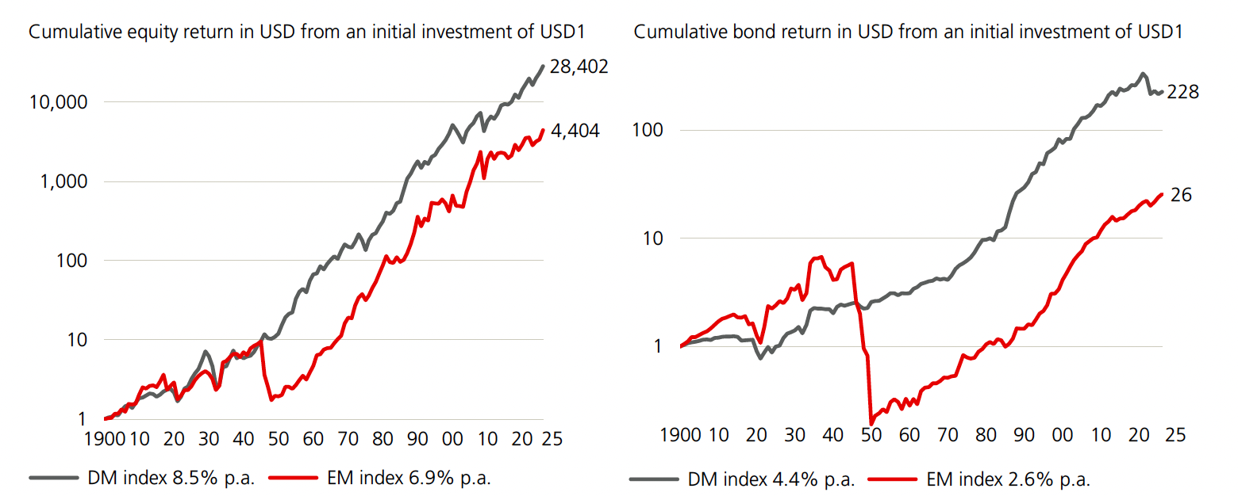
Developed Markets Outperform Emerging in the long-run
Source: UBS Global Investment Returns Yearbook 2026, available on Moodle

Slide 14
High yield fixed income
Rationale for Investment
High return than other fixed income
Lower risk than equity
Irrational (inefficient) pricing: possibility to beat the market
Claim on income senior to equity
Risks and Concerns
Ex-investment grade bonds consequently downgraded or bonds issued to finance leveraged buyouts
Credit risk
Liquidity risk

Slide 15
Convertible bonds
Rationale for Investment
Equity-debt hybrid
Claim senior to equity
Portfolio diversifier
Risks and Concerns
Prepayment risk (Callable)
Claim junior to bond
Complicated valuation

Slide 16
Cash equivalents
Rationale for Investment
Safe heaven in periods of negative financial returns
Low standard deviation
Portfolio diversifier (Low correlation with equity)
High liquidity
Risks and Concerns
Low return
Reinvestment risk
Inflation risk
Credit exposure

Slide 17
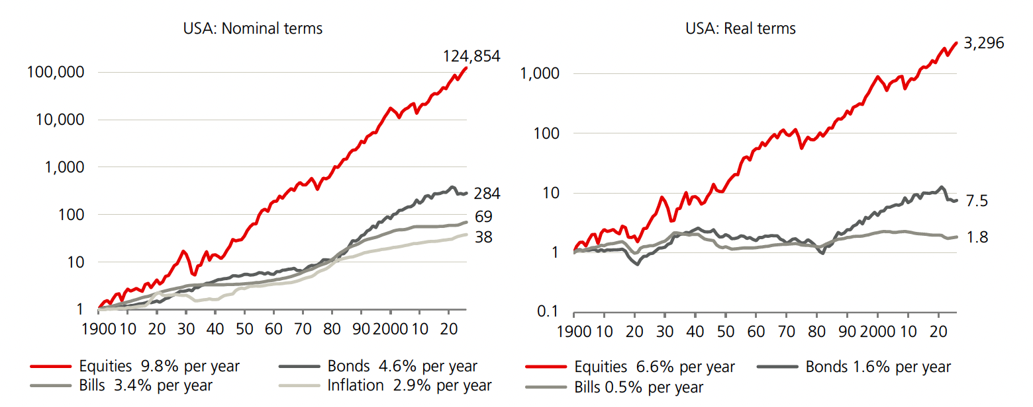
A historical look at cumulative returns from equities, bonds and cash (%): US
Source: UBS Global Investment Returns Yearbook 2026, available on Moodle

Slide 18
Alternative investments: Commodities - Gold
Rationale for Investment
Portfolio diversifier (Low correlation)
Inflation hedge
Safe haven in unstable times
Risks and Concerns
Geopolitical risks (volatility)
Poor performance in periods of low inflation
Illiquid assets
Concern over freezing central bank assets

Slide 19
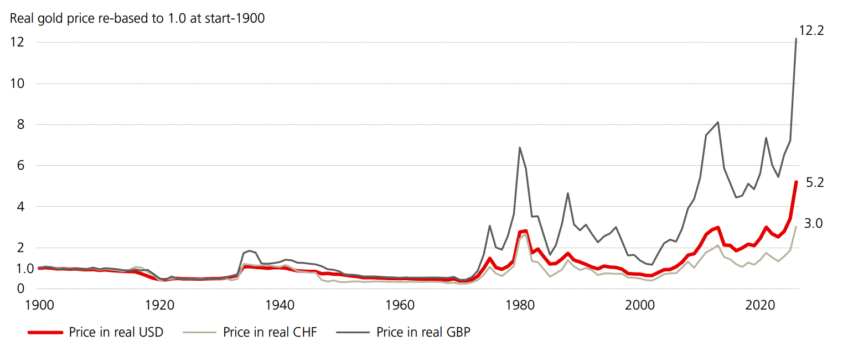
Source: UBS Global Investment Returns Yearbook 2026, available on Moodle

Slide 20
Alternative investments:
Hedge funds
Rationale for Investment
Possibility to beat the market (excess return or ‘alpha’ potential)
Broader opportunity set (opportunity to invest in overpriced assets as well as underpriced)
Portfolio diversifier (Low correlation with traditional assets)
Risks and Concerns
Funds collapse: e.g.LTCM
Return measurement ambiguous
High annual and performance fees

Slide 21
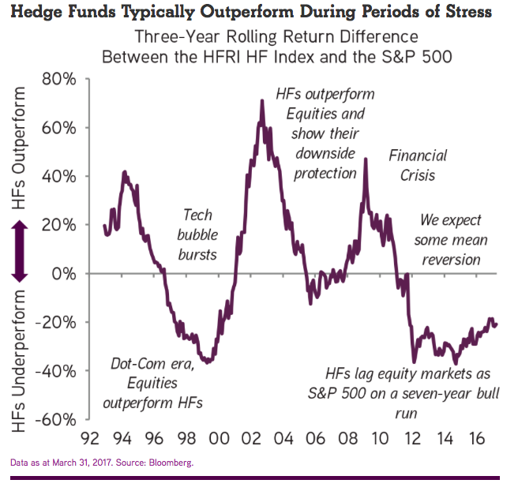

Slide 22
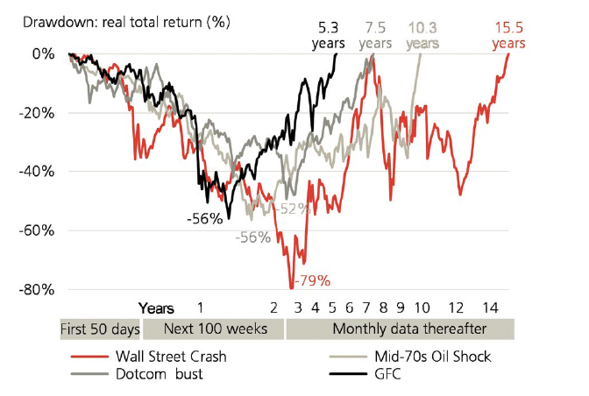
Historical length of recovery periods after crisis
(source: UBS Global Investment Returns Yearbook, 2025, available on Moodle)

Slide 23
Alternative investments: Private equity and credit
Rationale for Investment
High returns
Portfolio diversifier (Low correlation)
Irrational (Inefficient) pricing: Possibility to beat the market
Risks and Concerns
Irregular cash flows
High standard deviation
Returns measurement

Slide 24
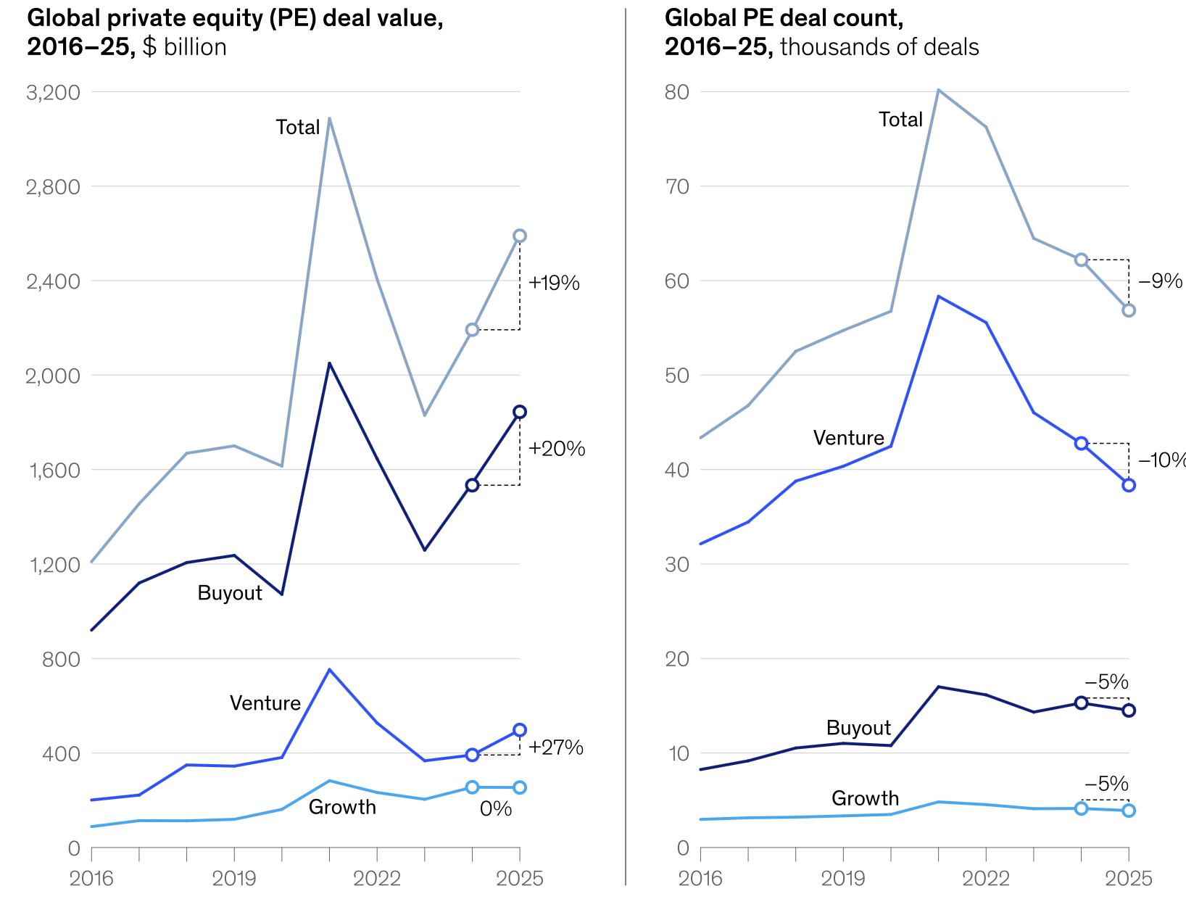
Global PE Deal Value and Deal Count
(Source: McKinsey Global Private Markets Report 2026, available on Moodle)

Slide 25
Alternative investments: Real estate
Rationale for Investment
Inflation hedge
Higher return
Low volatility
High and stable income stream
Portfolio diversifier (Low correlation)
Direct and indirect investment (Real Estate Investment Trusts, REITs)
Irrational (inefficient) pricing: possibility to beat the market
Risks and Concerns
Poor performance in periods of low inflation
Valuation not easy - continuous and reliable data unavailable
  Real Estate Price Indices exist as a guide
Bubble price movement: (REITs share price ≠ Net asset value)
Liquidity risk

Slide 26
Alternative Investments: Infrastructure
Rationale for Investment
Aspects of commodities (long term investment) and real estate (tangible)
Greater stability of cashflows than private equity
Lower expected IRR than private equity
Longer duration than private equity
Portfolio diversifier
Economic development funds investing in their own countries; capital maximization funds look for international opportunities
Risks and Concerns
Large up-front costs
Short history of performance (from early 2000s)
Lower expected IRR than private equity
More difficult to identify suitable performance index

Slide 27
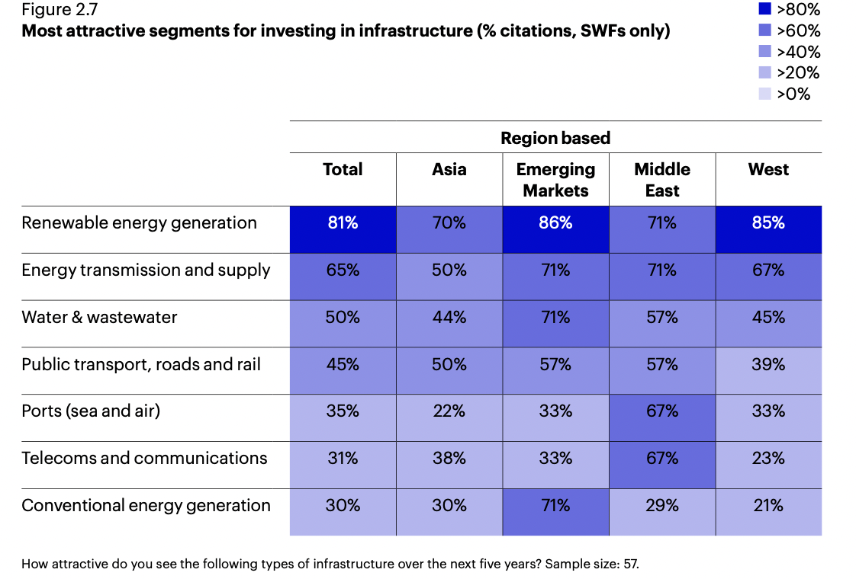
Invesco survey: Infrastructure considered the most attractive private market segment to invest in for SWFs (https://www.invesco.com/content/dam/invesco/apac/en/pdf/insights/2023/july/igsam-main-study-july-2023.pdf)

Slide 28
Integrating Alternatives with Traditional Asset Classes
Common issues across alternative asset classes:
Inadequate historical return data – time series not long enough
  Difficult to assess return correlations between traditional and alternative asset classes
  Important for construction of mean-variance frontier
Opacity
  Lack of clarity of hedge fund strategies, private equity valuation is private, commodity investment is via commodity futures whose returns are often at discrepancy with price changes in underlying commodities etc.

Slide 29
Integrating Alternatives with Traditional Asset Classes
Illiquidity
  Main criticism of alternatives: private equity investment locked up till the term of the fund, difficult to disinvest from infrastructure or real estate projects
  Liquidity budget – proportion of the assets you can afford to have tied up for a long time
  Why invest in illiquid assets? Illiquidity premium!!
    Smaller demand for illiquid assets – purchase price is lower
Higher costs
  High fees of hedge funds and private equity funds in particular
Due diligence
  Understand the characteristics of alternatives you invest in well

Slide 30
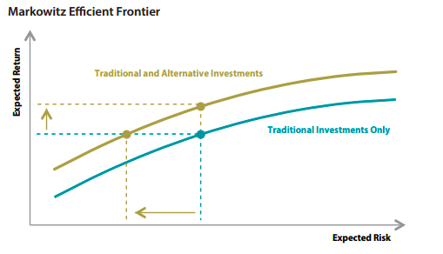
Integrating Alternatives with Traditional Asset Classes
So why still use alternatives given all these issues?
When combined with traditional assets they provide portfolio diversification (risk reduction)
  Lower overall portfolio risk and/or
  Higher overall portfolio return

Slide 31
Technicalities to start from: Risk, Return, Risk free asset and Risk Premium

Slide 32
Facts about risk and return
Concepts defined from the perspective of investor not issuer.
Assessment of risk and return represent the central issue for investment management
Investors are risk averse (like returns and dislike risk)
Return
Q4
Q1
Q3
Q2
Risk

Slide 33
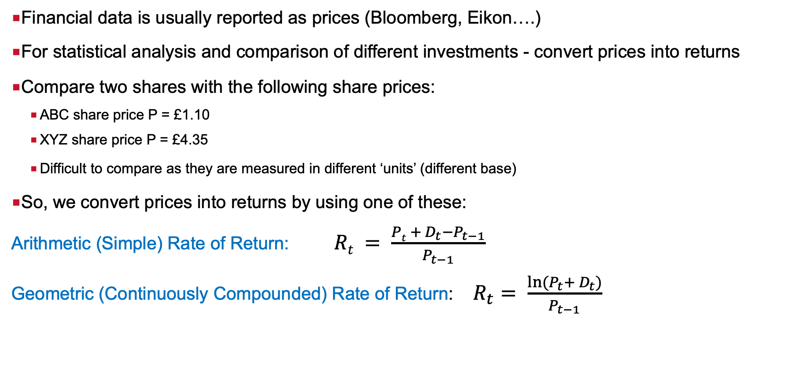
Converting Prices into Rate of Returns
Financial data is usually reported as prices (Bloomberg, Eikon….)
For statistical analysis and comparison of different investments - convert prices into returns
Compare two shares with the following share prices:
    ABC share price P = £1.10
    XYZ share price P = £4.35
    Difficult to compare as they are measured in different ‘units’ (different base)
So, we convert prices into returns by using one of these:
Arithmetic (Simple) Rate of Return: $Rt = \frac{Pt + D_{t}−P_{t−1}}{P_{t−1}}$
Geometric (Continuously Compounded) Rate of Return: $R_{t}= \frac{ln⁡(P_{t}+ D_{t})}{P_{t−1}}$

Slide 34
Converting Prices into Returns - Example
Suppose that stock ABC had the following end-of-month prices:
245p on 31st August
256p on 30th September
Anticipated dividend for the year is 10p, therefore on a monthly basis it will be 10p/12=0.83333p
The arithmetic monthly rate of return of this stock is:
R_{t} = (256 + 0.833 – 245)/245 = 0.048 = 4.8%
The geometric monthly rate of return of this stock is:
R_{t} = ln [(256 + 0.833)/ 245] =0.047 = 4.7%

Slide 35
Which rate of return to use?
  Differences of calculating the arithmetic or continuously compounded rate of return are small, especially for daily, weekly or even monthly data
  Geometric return has nice features. e.g. adding it you will obtain cumulative return of an asset/portfolio
  However, approaches we will use in investments to construct the efficient frontier (all portfolios that provide investors with minimum risk and maximum return) and select investor’s optimal portfolio are based on simple returns
Notes:
Advantages :
(1.)
(2.) After 2 periods wealth has not changed !!!
P_{t} = 100 P_{t+1} = 110 P_{t+2} = 100
Rt+1 = ln(110/100) = 9.531%
Rt+2 = ln(100/110) = -9.531%
Arithmetic Return would be :
Rt+1 = (110-100)/100 = 10%
Rt+2 = (100-110)/110 = -9.1%
Average = 0.45% (WRONG !!!).

Slide 36
Quantifying the Risk of an Investment
  Every investment involves some degree of uncertainty
    future selling price is unknown, future dividends are unknown, unknown future cash flows, …
    might have to sell assets due to emergency
    reinvestment rate might change (fall)
    increase in inflation changes the purchasing power of money
  Expected return (t = 0) is therefore uncertain and differs from the actual return (t = 1)
  To measure the risk of an investment, one needs to quantify the ‘uncertainty’, i.e. the difference between the actual and expected return:
    ‘Uncertainty’ = Actual Return - Expected Return

Slide 37
Scenario Analysis and Probability Distribution
  To quantify risk, address two questions :
    What Holding period return is possible ?
    How likely is it ?
  Scenario Analysis
    Assess different economic scenarios (outcomes)
  Probability Distribution
    Assign probabilities to possible outcomes
Notes:
Scenario Analysis
Process of devising a list of possible economic scenarios and specific likelihood of each one as well as HPR which will be realised in each case
Probability Distribution
List of possible outcomes with assiociated probabilities.

Slide 38
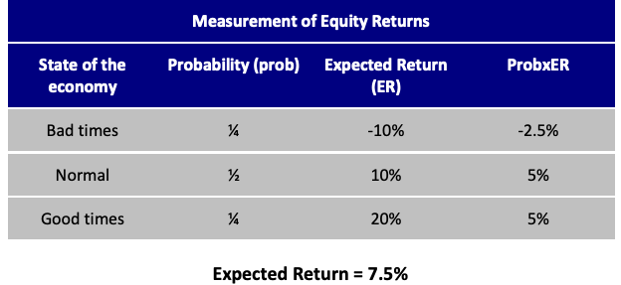
Example : Scenario Analysis

Slide 39
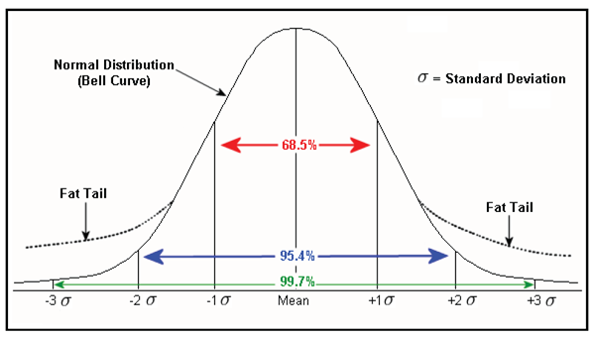
Standard Deviation (σ) and Variance (σ²)
  Measures of dispersion of actual return from expected return: variance is defined as average square ‘uncertainties’; standard deviation is the square root of variance
  Considered as measures of the total risk:
  Total Risk = Market (or systematic) + Company Specific (or unsystematic)
  Expected return (mean) and standard deviation are used as return and risk measures in investment decision making process because it is assumed that past asset returns follow normal distribution

Slide 40
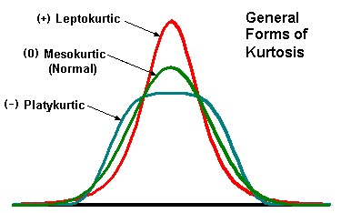
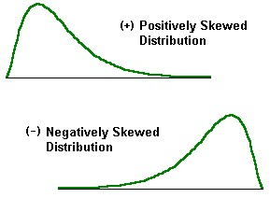
Skewness and Kurtosis
Kurtosis
Skewness
Measures asymmetry of distribution.
Risk averse investor dislikes negative skew.
Normal distribution skewness is 0
Kurtosis measures the degree of ‘fat-tails’ in a distribution.
Risk averse investor prefers low kurtosis.
Normal distribution kurtosis is 3

Slide 41
Tail Risk
‘Fat-tailed’ distribution: tendency of asset’s prices and return distributions to have more observations in the tails and to be thinner in the midrange than a normal (bell shaped curve) distribution
    The term ‘fat-tail’ refers to the unexpectedly high likelihood of an extreme event
Assets prone to price-jumps exhibit ‘fat-tailed’ distributions
Tail risk: asset (portfolio) price moving more than three standard deviations from its current price, i.e. in the area of ‘fat-tail’
    Also known as a ‘kurtosis risk’ as ‘fat-tailed ‘distribution has extremely large kurtosis
Most portfolio managers are interested in the downside movement
‘Black swan’ (extreme) events awareness
Critical to understand causes of fat tails and probability of recurrence

Slide 42
Semi-Deviation (σ_{D}) and Semi-Variance (σ_{D}²)
  Used by investors who are interested in downside deviation only
  A measure of the dispersion of all observations that fall below the mean (expected return) or target value of a data set (i.e. some investors may replace mean return with minimum target return for which zero or T-bill return are commonly used).
  Semi-variance is an average of the squared deviations of values that are less than the mean return or target value.
  Semi-deviation is a square root of semi-variance.

Slide 43
Risk Free Rate
Default free bond/bill issued by the government
In theoretical models assumed variance and standard deviation to be zero.
  (Not the case in the real world !)
Money market instrument such as UK 1 month Treasury Bill
  Short term instrument
  Liquid
  One cashflow at the end of time to maturity

Slide 44
Risk Premium and Risk Aversion
Risk free rate of return : rate of return which can be earned with certainty.
Risk premium : an expected return in excess of that on risk free securities
Risk Aversion: reluctance to accept risk
  Finance theory assumes that the only rational investors’ behaviour is risk-averse: for any extra unit of risk taken, investors require extra compensation (extra return).

Slide 45
References
Bodie, Kane and Marcus (BKM), “Investments” , Chapter 2 ‘Asset Classes and Financial Instruments’
Additional reports and papers used to produce these lecture notes are available on Moodle

Slide 46
Contact: natasha.todorovic.1@city.ac.uk
Room 4031
Bayes Business School, Bunhill Row, Level 4
Office hours: Tuesdays after the lecture

